Slide 1
Divide and Conquer
CS/IT, UCER Prayagraj

Slide 2
Divide and Conquer
divide the problem into a number of subproblems
conquer the subproblems (solve them)
combine the subproblem solutions to get the
solution to the original problem
Note: often the “conquer” step is done recursively

Slide 3
Divide and Conquer
•
Based on dividing problem into subproblems
Approach
Divide problem into smaller subproblems Subproblems must be of same type Subproblems do not need to overlap
Solve each subproblem recursively
Combine solutions to solve original problem
•
•

Slide 4
Analyzing Divide-and-Conquer Algorithms
For divide-and-conquer algorithms, we get
recurrences that look like:
{
Θ(1) if n < c
aT(n/b) +D(n) +C(n) otherwise
T(n) =

Slide 5
Analyzing Divide-and-Conquer Algorithms (cont.)
where
a
= the number of subproblems we break
the problem into
n/b = the size of the subproblems (in terms of n)
D(n) is the time to divide the problem of size n into the subproblems
C(n) is the time to combine the subproblem solutions to get the answer for the problem of size n

Slide 6
Quicksort

Slide 7
Design
Follows the divide-and-conquer paradigm.
Divide: Partition (separate) the array A[p..r] into two (possibly nonempty) subarrays A[p..q–1] and A[q+1..r].
Each element in A[p..q–1] ≤ A[q].
A[q] ≤ each element in A[q+1..r].
Index q is computed as part of the partitioning procedure.It is pivot element .
Conquer: Sort the two subarrays A[p..q–1] &
A[q+1..r] by recursive calls to quicksort.
Combine: Since the subarrays are sorted in place – no work is needed to combine them.

Slide 8
Pseudocode
Quicksort(A, p, r)
if p < r then
q <- Partition(A, p, r); Quicksort(A, p, q – 1); Quicksort(A, q + 1, r)
fi
Partition(A, p, r) x <- A[r],
i <- p – 1;
for j <- p to r – 1
do if A[j] ≤ x
then i <- i + 1;
A[i] ↔ A[j]
A[i + 1] ↔ A[r];
return i + 1
A[p..r]
 |  |  |  | 5
A[p..q – 1] A[q+1..r]
5
≤ 5 ≥ 5
Partition

Slide 9
Example
initially: |  | p 2 | 5 | 8 | 3 | 9 | 4 | 1 | 7 | 10 | r 6
 | i | j
next iteration: |  | 2 i | 5 j | 8 | 3 | 9 | 4 | 1 | 7 | 10 | 6
next iteration: |  | 2 | 5 i | 8 j | 3 | 9 | 4 | 1 | 7 | 10 | 6
next iteration: |  | 2 | 5 i | 8 | 3 j | 9 | 4 | 1 | 7 | 10 | 6
next iteration: |  | 2 | 5 | 3 i | 8 | 9 j | 4 | 1 | 7 | 10 | 6
note: pivot (x) = 6
Partition(A, p, r) x <- A[r],
i <- p – 1;
for j <- p to r – 1
do if A[j] ≤ x
then i <- i + 1;
A[i] ↔ A[j]
A[i + 1] ↔ A[r];
return i + 1

Slide 10
Example (Continued)
next iteration: | 2 | 5 | 3 i | 8 | 9 j | 4 | 1 | 7 | 10 | 6
next iteration: | 2 | 5 | 3 i | 8 | 9 | 4 j | 1 | 7 | 10 | 6
next iteration: | 2 | 5 | 3 | 4 i | 9 | 8 | 1 j | 7 | 10 | 6
next iteration: | 2 | 5 | 3 | 4 | 1 i | 8 | 9 | 7 j | 10 | 6
next iteration: | 2 | 5 | 3 | 4 | 1 i | 8 | 9 | 7 | 10 j | 6
next iteration: | 2 | 5 | 3 | 4 | 1 i | 8 | 9 | 7 | 10 | 6 j
after final swap: | 2 | 5 | 3 | 4 | 1 i | 6 | 9 | 7 | 10 | 8 j
Partition(A, p, r) x <- A[r],
i <- p – 1;
for j <- p to r – 1
do if A[j] ≤ x
then i <- i + 1;
A[i] ↔ A[j]
A[i + 1] ↔ A[r];
return i + 1

Slide 11
Algorithm Performance
•
Running time of quicksort depends on whether the partitioning is balanced or not.
Unbalanced Partition
Partition is called unbalanced when Sub problem 1 is of size n – 1, and subproblem 2 is of size 0 or vice versa.
Otherwise partition is called balance partition.

Slide 12
Worst-case Partition Analysis
Recursion tree for worst-case partition
n
n – 1
Running time for worst-case partitions at each recursive level:
T(n) = T(n – 1) + T(0) +PartitionTime(n)
= T(n – 1) + Θ(n)
=T(n – 1) + n
=T(n – 2) + (n -1) +n
=T(n – 3) + (n -2) +(n-1)+n……..
=T(0)+1+2+3…. (n -2) +(n-1)+n
=n(n+1)/2
T(n) = Θ(n²)
•
n – 2
n
•
•
•
•
•
n – 3
2
1

Slide 13
Best-case Partitioning
Size of each subproblem ≤ n/2.
One of the subproblems is of size ⎣n/2⎦
The other is of size ⎡n/2⎤ −1.
Recurrence for running time
T(n) ≤ 2T(n/2) + PartitionTime(n)
T(n) = 2T(n/2) + Θ(n)
By master method we get a=2 , b=2 , f(n)= n
T(n) = Θ(n lg n)

Slide 14
Best-case Partitioning
T(n) = 2T(n/2) + Θ(n)
By master method we get a=2 , b=2 , f(n)= n
_{n}log_{b}a _{= n}log₂ 2
Since, f(n)=n
Thus, f(n)= n^{logba}
Case 2 applies:
f (n) = Θ(n^{logb a})
n = Θ(n) satisfied
Thus the solution is T(n) = Θ(n log n).

Slide 15
Recursion Tree for Best-case Partition
cn
cn
cn/2
cn/2
cn
lg n
cn/4
cn/4 cn/4
cn/4
cn
c c c
c c c
cn
Total
: O(n lg n)

Slide 16
Conclusion
•
•
•
Divide and conquer is just one of several powerful techniques for algorithm design.
Divide-and-conquer algorithms can be analyzed using recurrences and the master method (so practice this math).
Can lead to more efficient algorithms
•

Slide 17
Divide and Conquer (Merge Sort)

Slide 18
Divide and Conquer
Recursive in structure
Divide the problem into sub-problems that are similar to the original but smaller in size
Conquer the sub-problems by solving them recursively. If they are small enough, just solve them in a straightforward manner.
Combine the solutions to create a solution to the original problem

Slide 19
An Example: Merge Sort
Sorting Problem: Sort a sequence of n
elements into non-decreasing order.
Divide: Divide the n-element sequence to be sorted into two subsequences of n/2 elements each
Conquer: Sort the two subsequences recursively using merge sort.
Combine: Merge the two sorted subsequences to produce the sorted

Slide 20
Merge Sort – Example
Original Sequence
Sorted Sequence
18 | 26 | 32 | 6 | 43 | 15 | 9 | 1
1 | 6 | 9 | 15 | 18 | 26 | 32 | 43
18
26
32
6
43
15
9
1
18 | 26 | 32 | 6
43 | 15 | 9 | 1
6 | 18 | 26 | 32
1 | 9 | 15 | 43
18
26
32
6
43
15
9
1
6
18
26
32
1
9
15
43
18 | 26 |  | 32 | 6
43 | 15 |  | 9 | 1
18 26 6 32 15 43
1 9
18
26
32
6
43
15
9
1
18
26
6
32
15
43
1
9
6 |  | 43 | 15
 |  | 18 |  |  | 26 |  |  | 32 |  |  | 6 |  |  | 43 |  |  | 15 |  | 9 |  | 1 |  | 18 |  | 26 |  | 32 |  |  |  |  |  |  | 9 |  | 1
 |  | 18 |  |  | 26 |  |  | 32 |  |  | 6 |  |  | 43 |  |  | 15 |  | 9 |  | 1
18
26
32
6
43
15
9
1
18
26
32
6
43
15
9
1
18
26
32
6
43
15
9
1

Slide 21
Merge-Sort (A, p, r)
INPUT: a sequence of n numbers stored in
array A
• OUTPUT: an ordered sequence of n
numbers
MergeSort (A, p, r) // sort A[p..r] by divide & conquer
1 if p < r
2 then q ← ⎣(p+r)/2⎦
MergeSort (A, p, q)
MergeSort (A, q+1, r)
Merge (A, p, q, r) // merges A[p..q] with A[q+1..r]
Initial Call: MergeSort(A, 1, n)

Slide 22
Procedure Merge
Merge(A, p, q, r)
1 n₁ ← q – p + 1
2 n₂ ← r – q
for i ← 1 to n₁
⬥ do L[i] ← A[p + i – 1]
for j ← 1 to n₂
do R[j] ← A[q + j]
⬥ L[n₁+1] ← ∞
⬥ R[n₂+1] ← ∞
⬥ i ← 1
⬥ j ← 1
for k ←p to r
do if L[i] ≤ R[j]
then A[k] ← L[i]
⬥ i ← i + 1
else A[k] ← R[j]
⬥ j ← j + 1
Input: Array containing sorted subarrays A[p..q] and A[q+1..r].
Output: Merged sorted subarray in A[p..r].
Sentinels, to avoid having to check if either subarray is fully copied at each step.

Slide 23
Merge – Example
A
… | 1 | 6 | 8 | 9 | 26 | 32 | 42 | 43 | …
6
8
26
32
1
9
42
43
k
k
k
k
k
k
k
k
k
L
6 | 8 | 26 | 32 | ∞
R
1 | 9 | 42 | 43 | ∞
6
8
26
32
1
9
42
43
i
i
i
i
i
j
j
j
j
j

Slide 24
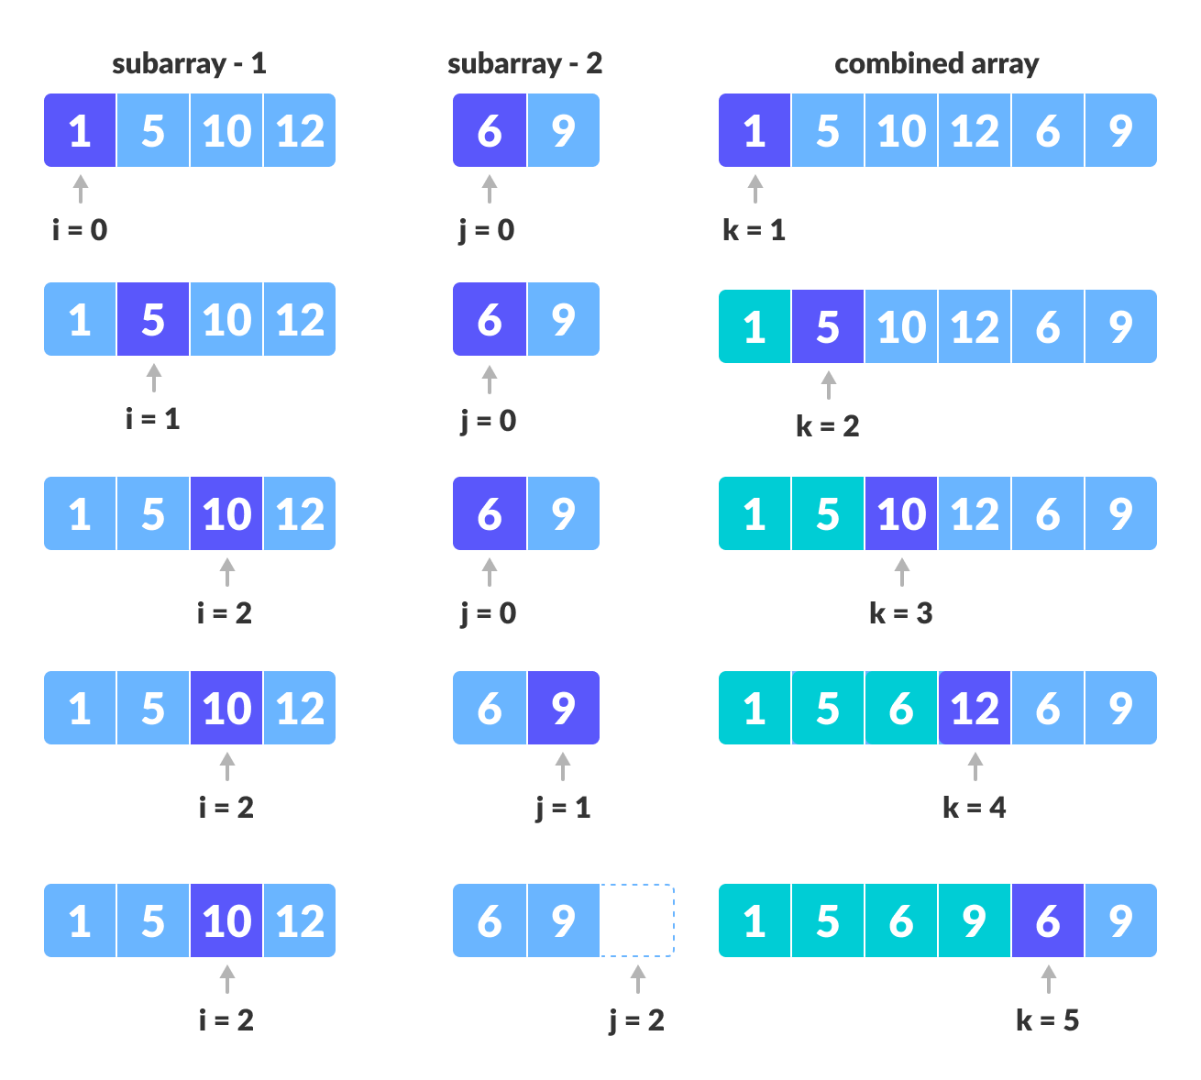

Slide 25
Analysis of Merge Sort
Running time T(n) of Merge Sort:
Divide: computing the middle takes Θ(1)
Conquer: solving 2 subproblems takes 2T(n/2)
Combine: merging n elements takes Θ(n)
Total:
T(n) = Θ(1)
T(n) = 2T(n/2) + Θ(n)
if n = 1 if n > 1
T(n) = Θ(n lg n)

Slide 26
Analysis of Merge Sort
T(n) = 2T(n/2) + Θ(n)
By master method we get a=2 , b=2 , f(n)= n
_{n}log_{b}a _{= n}log₂ 2
Since, f(n)=n
Thus, f(n)= n^{logba}
Case 2 applies:
f (n) = Θ(n^{logb a})
n = Θ(n) satisfied
Thus the solution is T(n) = Θ(n log n).

